Slide 1


REPORT ON ECOMMERCE SALES
BY
N.NITHISH KUMAR

Slide 2
Goal of the report: Work with data sets using Power BI Tool. To analyze data with the help of dashboards and report and derive insights.
About Data:
The below data sets were (one of leading eCommerce company). This data is about customer behavior which contains data of multiple user events. The duration of the data for two months.
Sales_Data_Ecommerce : The entire customer behavior data
2. Promotion: This is promotion data set of special promotions for that day. One product will be promoted in first page of app/website. In addition to that there are many promotions running however the data is limited special promotion.

Slide 3
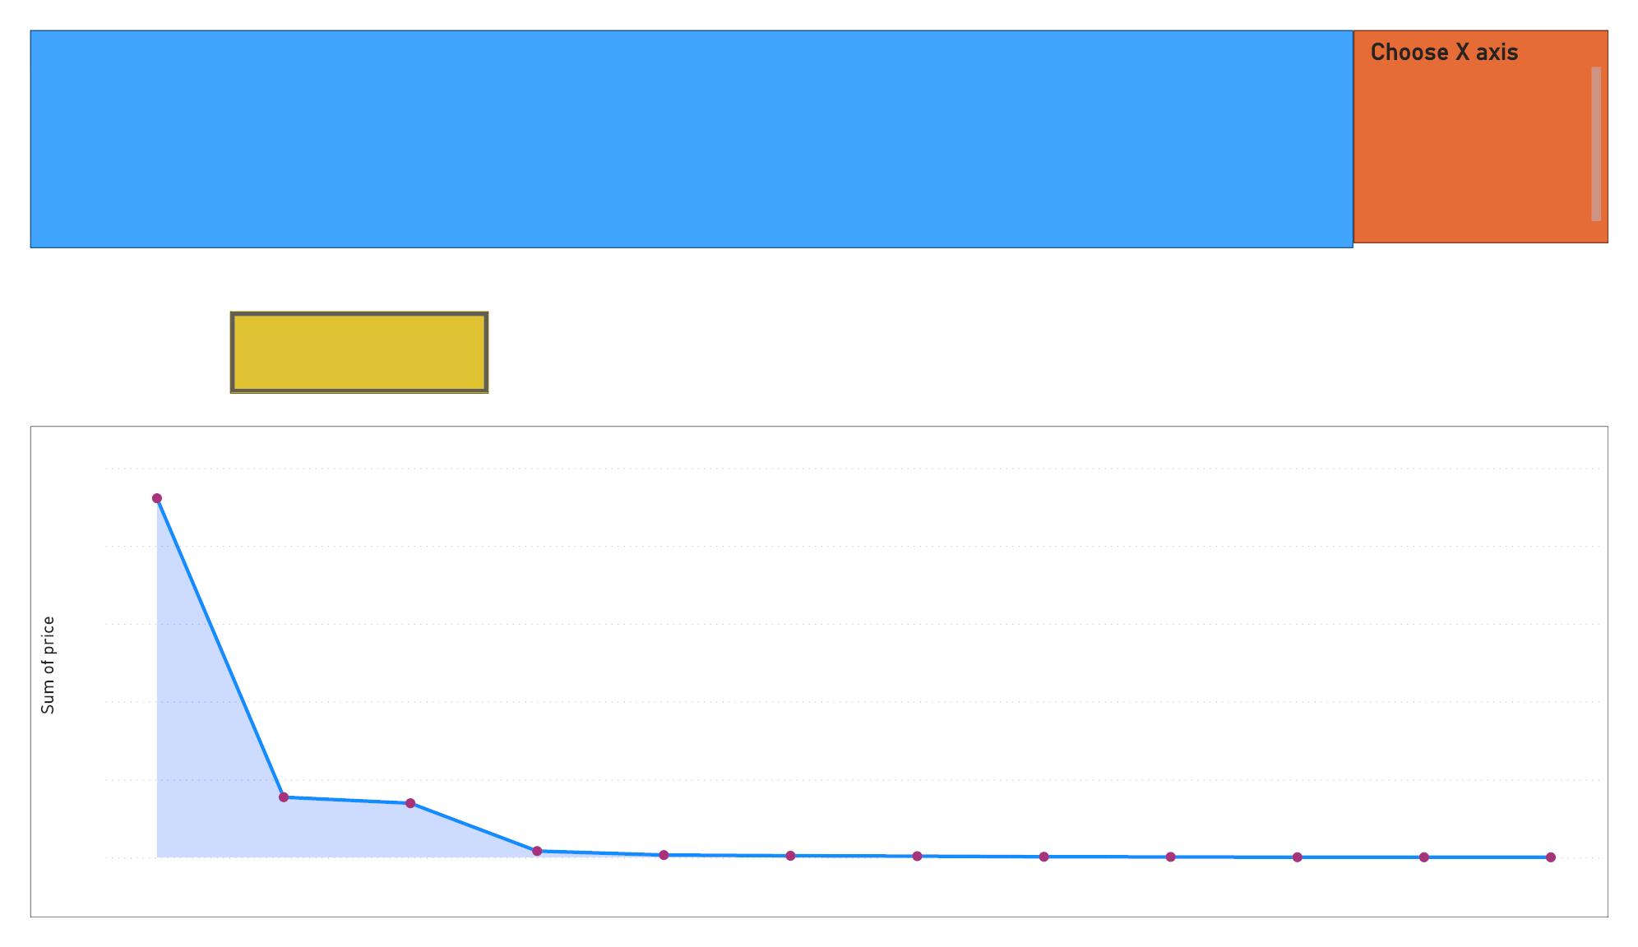
HOW IS PRICE IS VARYING BY
BRAND/CATEGORY/CHANNEL/EVENT HOUR ?





brand
category
Channel
event_hour
Home Page
Sum of price by category
50M
40M
30M
20M
10M
0M
46.10M
7.72M
6.95M
0.81M
0.29M
0.20M
0.15M
0.07M
0.05M
0.01M
0.01M
0.00M
Electronics
Computers
Appliances
Furniture
Construction
Apparel
Auto
Sport
Kids
Accessories
Country_yard
Stationery
category

Slide 4
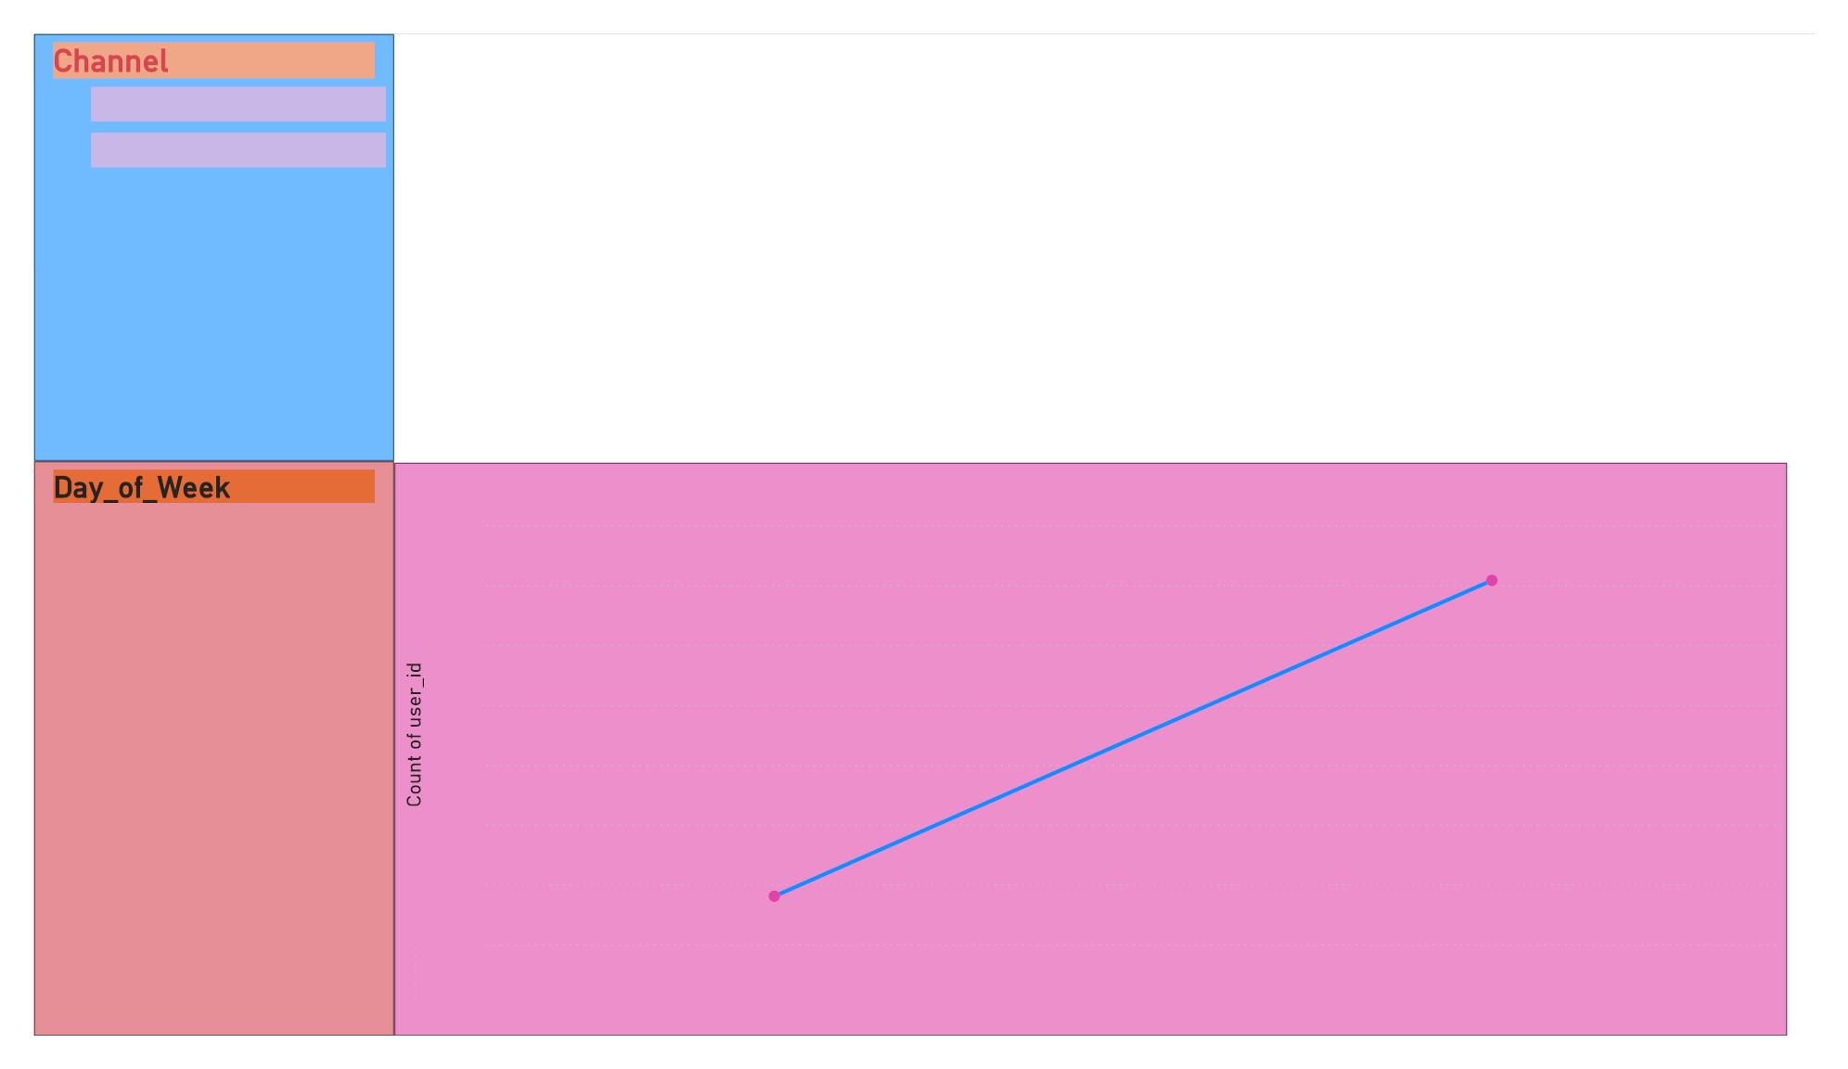



App
Browser
 Count of user_id by Day_of_Week and Channel







Friday
9,100
Monday
Saturday
Sunday
9054.00
9,050
9,000
8,950
8,900
8,850
8,800
Thursday
Tuesday
Wednesday
8790.00
App
8,750
Browser
Monday
Channel

Slide 5
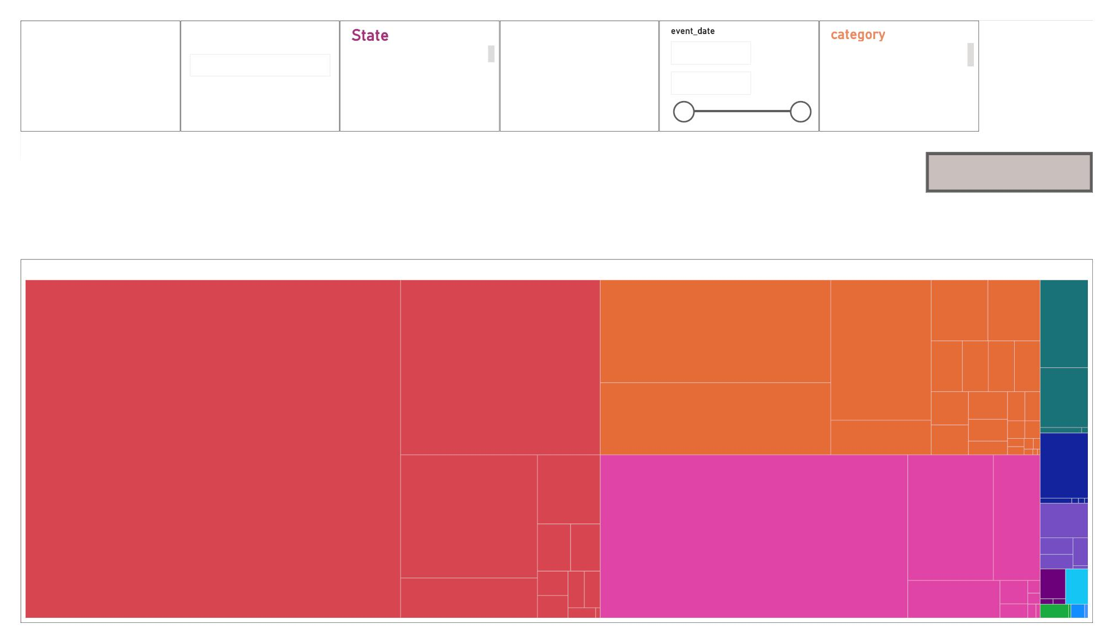
Month

 Channel



12.95M
Potential_Revenue
All
 AK

App
01-10-2019 
 Accessories

AL


Apparel


 Browser
30-11-2019 
AR
Appliances
CLEAR ALL FILTERS
Revenue by category and sub_category2
Electronics
Appliances
Furn…
dishwash… blender…
bed 7.…
refrigerators 44.48K
air_… ir… w… h…
vacuum 26.45K
ove…
micr…
cabine…
meat…
App…
tv 65.55K
washer 31.25K
sewing_machine 6.… hoo…
Computers
shoes …
headphon…
Con…
clocks 31.59K
tablet 10.32K
aco… ph…
desktop 20.20K
printer…
vi…
pr…
smartphone 238.14K
mi…
notebook 94.25K
monitor 6.51K

Slide 6
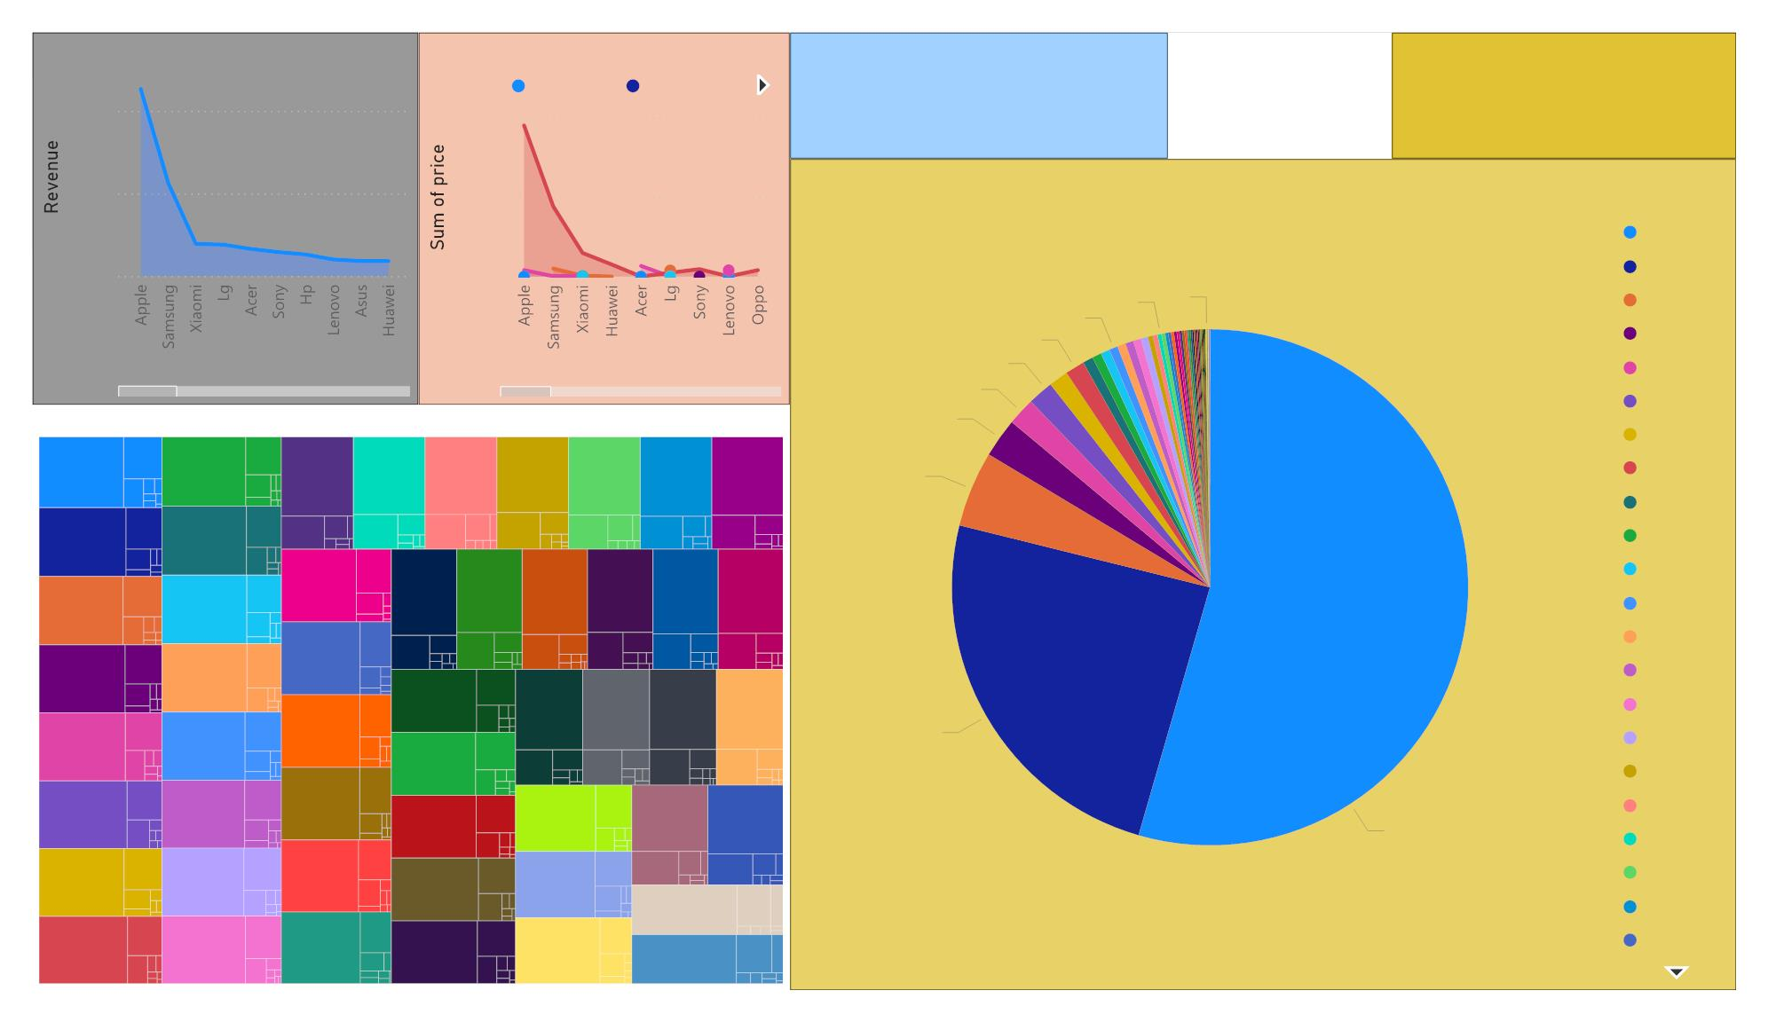
Revenue by brand
Sum of price by brand and category
Channel

Month
 10
 11

category
Accessories Apparel
 App
100K
10M
 Browser
Potential_Revenue by brand
50K
0K
5M
0M
brand
Apple
Samsung
Xiaomi
Huawei
Acer
0.01M
(0.25%)
0M
(0.04%)
0.02M (0.54%)
0.06M (1.21%)
0.07M (1.61%)
brand
brand
0.08M (1.72%)
0.11M (2.46%)
Count of user_id by State and category
Lg
LA
MA
KY
MO
NJ
OR
VA
MT
WI
Oppo
Sony
Electron…
CT
Electron…
TN
0.22M (4.74%)
Electr… Electr… Electr…
Electr… Electr…
A… A…
Electr…
A…
Electr…
Lenovo
Bosch
Indesit
Beko
A…
A…
A…
A…
AZ
Electroni…
GA
Electron…
AL
ND
MD
SC
NE
IL
DE
Electro…
NC
Electr…
Electr… Electr… Electr… Electr… Electr…
Electron…
OK
Electron…
WY
Hp
A…
A…
A…
VT
A…
CO
Asus
Electroni…
ID
Electron…
NY
Electro…
TX
NM
UT
ME
Electron…
AK
Haier
Electr… Electr… Electr… Electr…
A… A… A…
1.13M (24.4%)
Artel
Electroni…
MS
Electron…
NH
Electro…
MN
Philips
Vivo
Electron…
RI
DC
WA
PA
Electroni…
IN
Electron…
WV
Electro…
SD
Electron…
KS
Electro…
HI
Electro… Electro…
2.52M (54.46%)
Canon
Dauscher
Janome
Tefal
Ap…
CA
Ap…
Electron…
FL
Electro…
NV
Electro…
IA
Electroni…
MI
Electro…
AR
Electronics
Electron…
Electro…
Electroni…
Electron…
OH

Slide 7
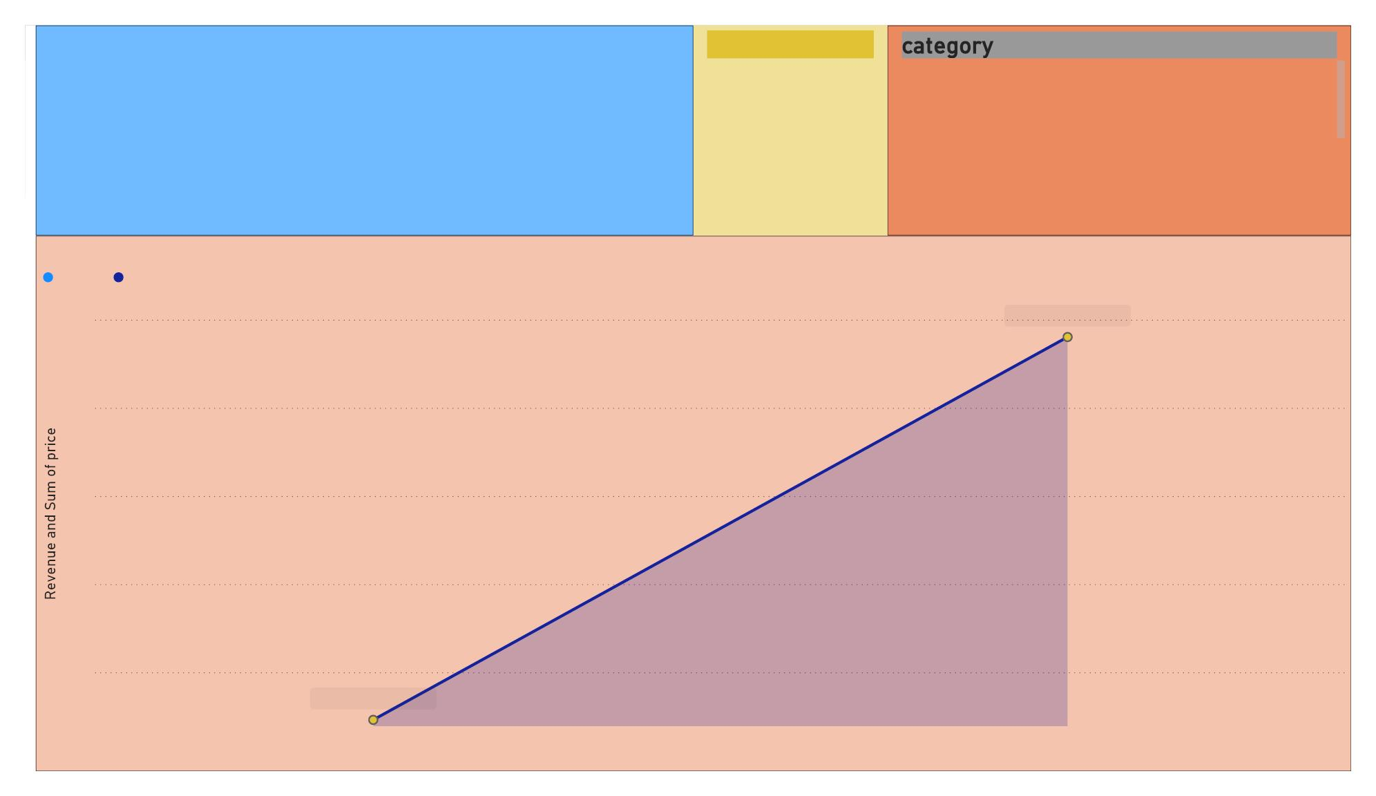
FROM VISUAL WE CAN S AY THAT PRICES ARE FLUCTUVATING event_type 

MORE IN OCTOMBER AND NOVEMBER.PROMOTIONS ALSO
EFFECTING THE SALES IN THESE TWO MONTHS .ALSO
SEARCH ACTIVITY IS HIGH IN OCT AND NOV..........



Cart






Accessories
Apparel
Purchase
View
Appliances
Auto
Computers
Construction
Revenue and Sum of price by Month
Revenue Sum of price
75K
70K
65K
60K
Sum of price 74.02K
55K
Sum of price 52.30K
10
11
Month

Slide 8
Final Deliverables: a. Analytics Dashboard using Power BI Tool b. Detailed document summarizing the insights
THANK YOU

